Slide 1
GROUP 9 - DICTIONARY
Professor: Kalu
Team members:
Adnan Shehzad (610534)
Sibtain Raza (610523)
Vo Nguyen (610507)

Slide 2
Agenda
Intro
Use-case
Class diagram
solution
Solution architecture
Database design model (e-r diagram)
applied patterns

Slide 3
1. intro
Goal : Dictionary WAP
Increasing the vocabulary for user
Brief Description: Given Problem & Solution
Manage user , user’s history search in our Dictionary Wap
Simple UI & friendly
Provide result by own Database
Extend by getting data from an API

Slide 4
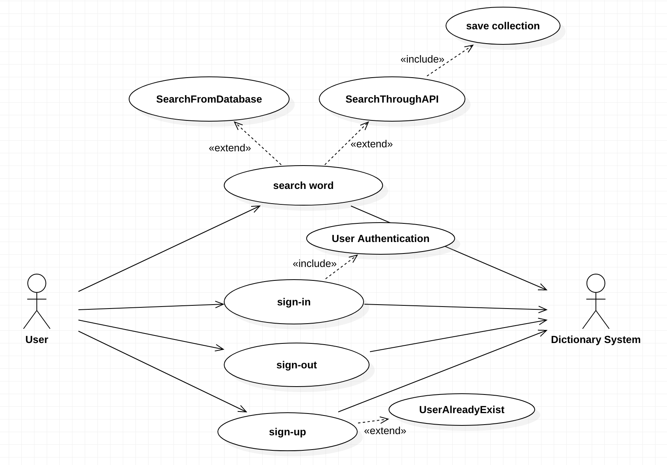
2.use-case

Slide 5
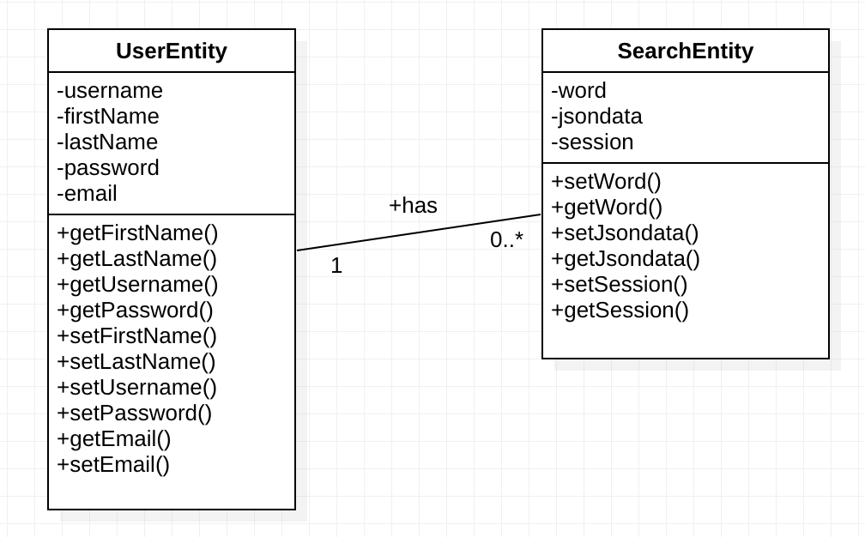
3.Class diagram

Slide 6
4.1 Solution Architecture
Architecture
Front-End: html/css/bootstrap/jsp/javascript
Back-End: servlet
MySQL
Implement own WORDAPI by json

Slide 7
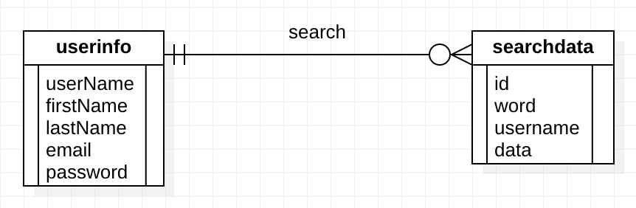
4.2 Database Design Model (E-R diagram)

Slide 8
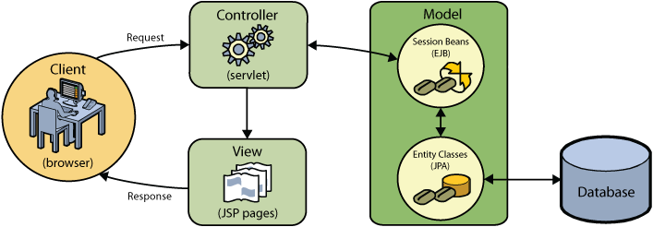
4.3 Applied Patterns
MVC Model

Slide 9
Thank you

